Slide 1
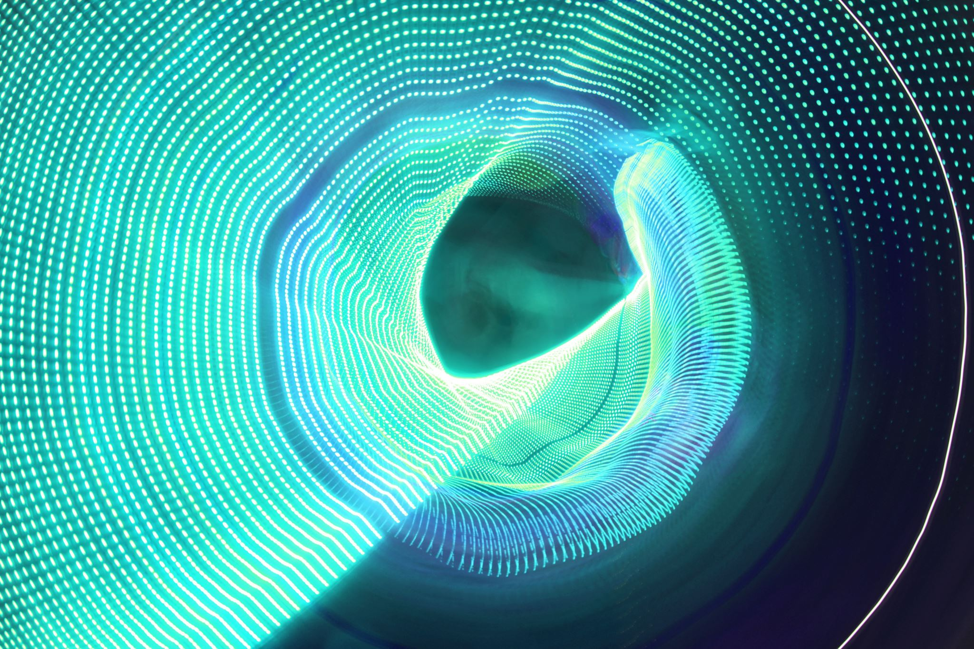
Who Made God?

Slide 2
Why do we think everything must have a beginning and end?
Why do we think that God had a starting point?

Slide 3

Do you believe that the sun will rise tomorrow? Why?
Experience! – it has always happened before.

Slide 4

Does your strip of paper have a beginning and end?
This Photo by Unknown Author is licensed under CC BY

Slide 5
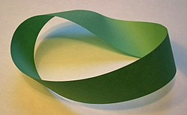
A Möbius strip
This Photo by Unknown Author is licensed under CC BY-SA

Slide 6
Who Made God?
The Lord God says, “I am the Alpha and the Omega. I am the One who is and was and is coming. I am the All-Powerful.”
Revelation 1:8
‘I am the Alpha and the Omega, the First and the Last, the Beginning and the End.’ Revelation 22:13
22:13 the Alpha and the Omega are the first and last letters in the Greek alphabet. This means “the beginning and the end.”

Slide 7
Who Made God?
If God is the beginning and end, if He made the beginnings and ends of everything then He made time and the way to measure it. Christians see this in Genesis 1:14
Then God said, “Let there be lights in the sky to separate day from night. These lights will be used for signs, seasons, days and years.”

Slide 8
Who Made God?
If God is the Creator of time itself then He is outside of the limits of time.
“Stand up and praise the Lord your God, for he lives from everlasting to everlasting.Praise his glorious name! It is far greater than we can think or say.” Nehemiah 9:5
Christians believe that no one needed to make God because He was always there…

