Slide 1

RE Lesson One
Prayer In Colour
Prayer In Art
Reflection

Slide 2
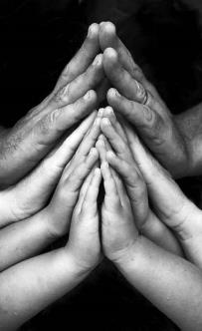
There are 4 main reasons for people praying:
to praise,
to give thanks,
to say sorry (repent)
ask for something (forgiveness)
Play this movie clip from Bruce Almighty https://www.youtube.com/watch?v=mksGYtUKhZs

Slide 3

Do you think God can reply to EVERY prayer?
Do you think Bruce solved the problem by answering through email with the ‘yes to all?’
God must get millions of prayers and every prayer is a conversation with Him for a different reason.

Slide 4
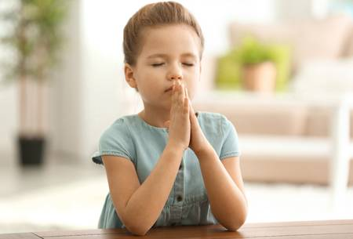
But sometimes…
your words can disappear,
you can become confused,
you may lose interest,
you may get bored,
you may go back to prayers you just know,
you may run out of words,
you might not be able to find the words you want to say.
So let’s solve this problem ☺

Slide 5
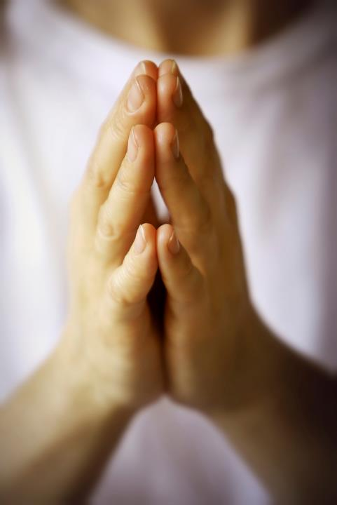
These RE lessons will help us to think of the words and ideas we want to talk to God about.
We will learn how to focus, reflect, find that stillness, how to be more spiritual and quiet through prayer.
For Christians prayer helps them to learn ‘how to hear the still small voice or gentle whisper of God’ (1 Kings 19:12)

Slide 6
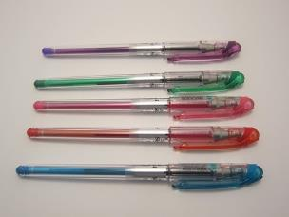

Prayer In Colour
Step One: What do I need?
A selection of pens, pencils, felt tips, colouring pencils or wax crayons.
2 plain sheets of paper

Slide 7
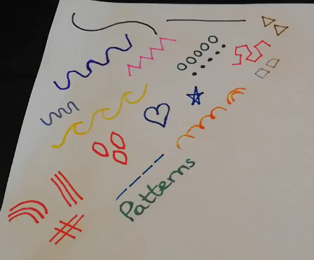
Prayer In Colour
Step Two: Make some patterns
Top Tip:
Don’t make these too big! You will use them to decorate small sections on your prayer.
First I would like you to make some patterns in the corner of your paper.
Here are my examples.
You could look at an artist called Romero Britto for more examples.
Top Tip:
You could practice on a separate piece of paper if you wanted, just keep them handy.

Slide 8
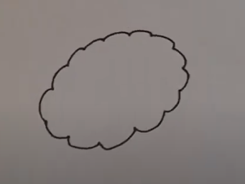
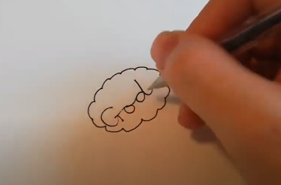
Prayer In Colour
Step Three: People in my prayer
This prayer is about the important people in your life.
After creating your patterns you need to draw a shape in the middle of your paper.
If you want to make this a prayer to God, write God in the middle. If you choose to make yours as a mindfulness task, just leave this empty.
As you are doing this start to think about 6-8 people who are important in your life.

Slide 9
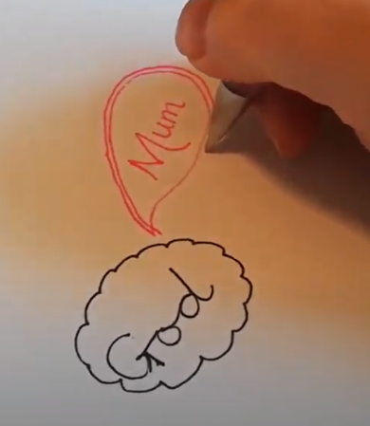
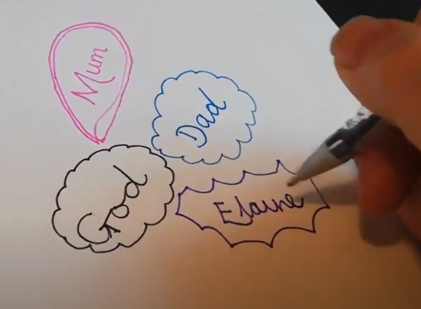
Prayer In Colour
Step Three: People in my prayer
Think about why you love them.
Think about their favourite colours.
Then draw a bubble or shape and write one persons name inside around God’s name.
Talk to God about that person. Talk about what they mean to you or what they need help with.
Continue to think about those special people around you.

Slide 10
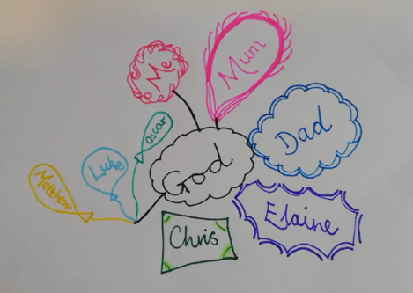
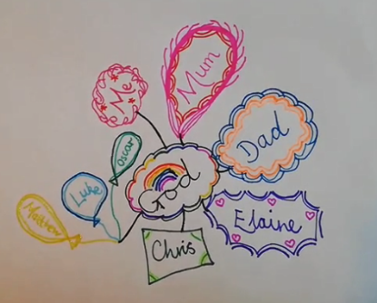
Prayer In Colour
Step Four: Patterns and Connect
Fill the space around God with people who you want to pray for or talk to Him about.
Use some of the patterns you worked on to decorate the bubbles.
Draw a line to connect everyone to God, after all we are all His children.

Slide 11
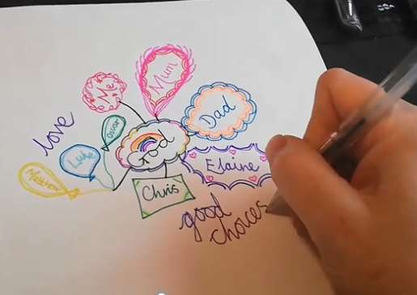
Prayer In Colour
Step Five: Focus for prayer
Once you are happy with your prayer about your special people, I want you to think about how God could help them. What did you say to God in your thoughts?
Around the outside of your prayer bubbles, write the focus words that came into your prayer to help you reflect.

Slide 12
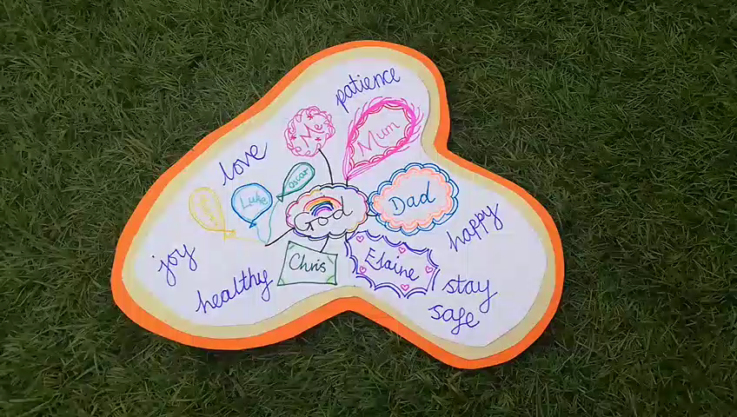
Prayer In Colour
Step Six: Prayer in art
Now cut out your prayer and put it onto some beautiful bright card.
Remember what Jesus taught us about prayer?
Be honest about how you feel.
Try being quiet and still and think about what you want to say to God.
Hopefully this will help to organise your thoughts and give you the words you want to say.

Slide 13
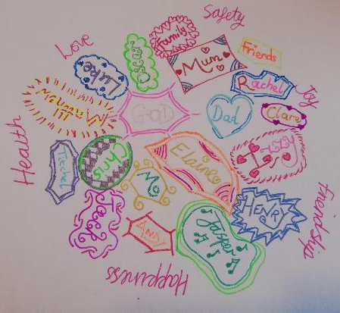
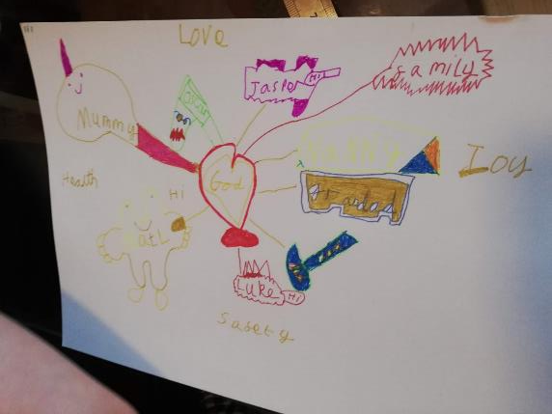
Top Tip:
You can make it as complicated or simple as you like.
The example to the left has most of my family, including nieces, nephews and cousins.
The example below is my son’s prayer in art.
Top Tip:
Remember it does not have to be aimed at God, you can use this to count your blessings, think about those you love or who you miss, those who are ill or no longer with us. Just spend time together either talking or in still silence. Focus your mind and be grateful for those who make a difference to our lives.

