Slide 1
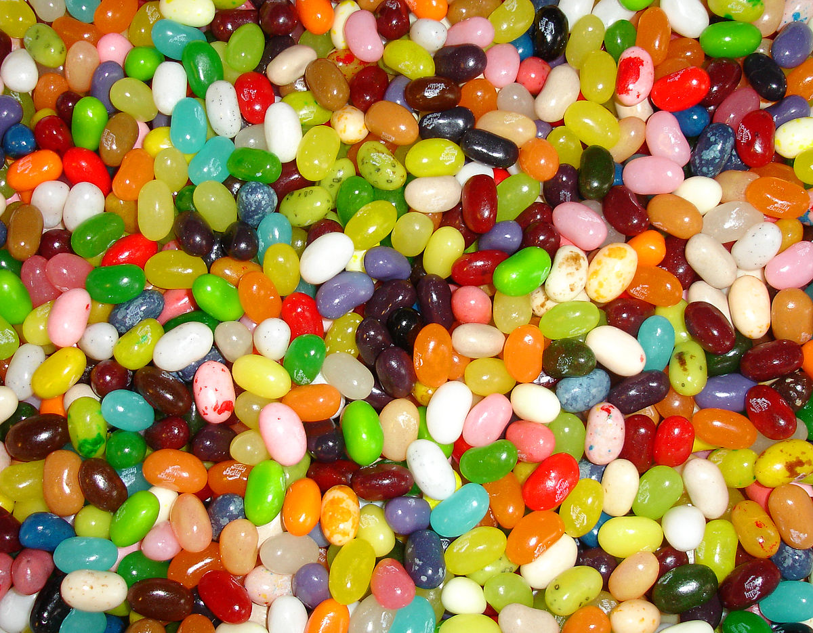
Jelly Bean Prayers

Slide 2
You can say a prayer in many different ways.
Prayers are not only said in the hall for Collective Worship or before leaving the school day.
There are many different ways to pray and speak to God. Over the next few RE lessons you will be able to explore prayer and how to become more spiritual through practical and creative ways.
However, you do not need to say prayers to God if you do not want to. You can spend a small amount of time in the day to be still, reflective, thinking of others or the things you are grateful for in your life. You can use these prayer ideas as stimulus.

Slide 3





Jelly bean prayers
1) Grab a bag of jelly beans or smarties. 2) Find somewhere quiet
3) Open the bag and take one of every colour
4) Every colour bean represents something to focus on in your prayer

Slide 4
Jelly bean prayers
Red
The colour of Jesus’ blood when he died.
The colour of Jesus’ love for us.
Thank God for Jesus.

Slide 5
Jelly bean prayers
Orange
The colour of happiness.
Pray for something or someone who makes you happy.

Slide 6
Jelly bean prayers
Yellow
The colour of light.
The colour of the sun.
Pray about the things that make you shine.

Slide 7

Jelly bean prayers
Green
The colour of jealousy.
The colour of trees.
Pray to say thank you for our wonderful world.

Slide 8
Jelly bean prayers
Blue
The colour of water.
The colour of day.
Pray for the people of the world to have water and praise for each new day.

Slide 9
Jelly bean prayers
Purple
The colour for sorry and repentance.
Pray for something you have done wrong and ask for forgiveness.

Slide 10
Jelly bean prayers
Pink
The colour of love.
Pray for someone you love dearly.

Slide 11
Jelly bean prayers
White
The colour of purity.
The colour of newness.
Pray for babies new in the world and say thank you for new beginnings.

Slide 12
Jelly bean prayers
Brown
The colour of soil.
The colour of chocolate.
Pray to say thank you for the food that grows in the ground.

