Slide 1

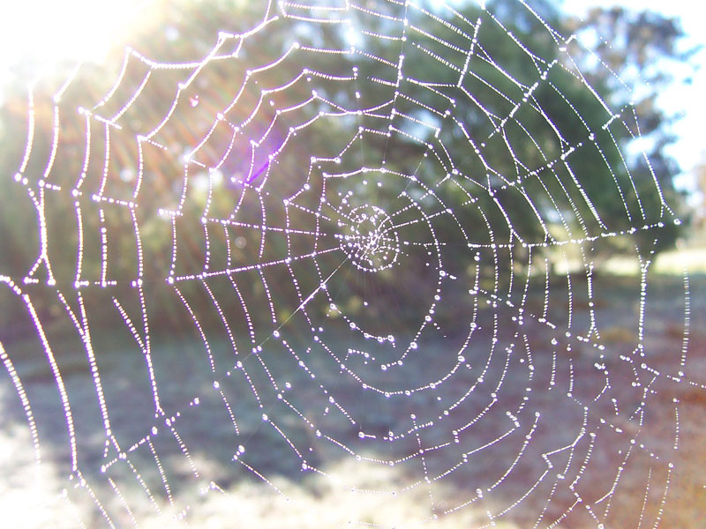
Prayer Webs

Slide 2
You can say a prayer in many different ways.
Prayers are not only said in the hall for Collective Worship or before leaving the school day.
There are many different ways to pray and speak to God. Over the next few RE lessons you will be able to explore prayer and how to become more spiritual through practical and creative ways.
However, you do not need to say prayers to God if you do not want to. You can spend a small amount of time in the day to be still, reflective, thinking of others or the things you are grateful for in your life. You can use these prayer ideas as stimulus.

Slide 3
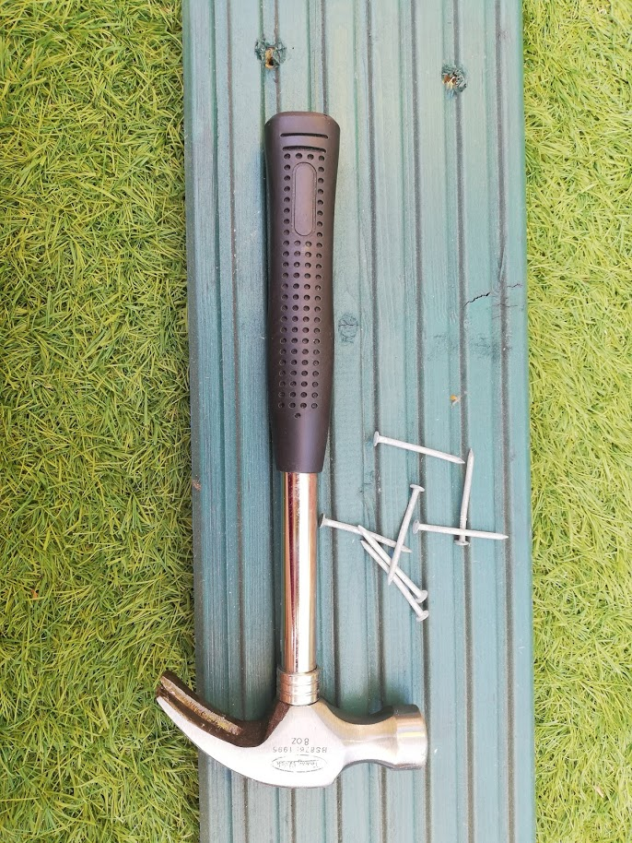
To make a prayer web you will need:
A piece of wood (we used a piece of old floor decking)
A hammer
5 nails
Yarn or string
Safety googles (if you have a pair)
An adult to supervise

Slide 4
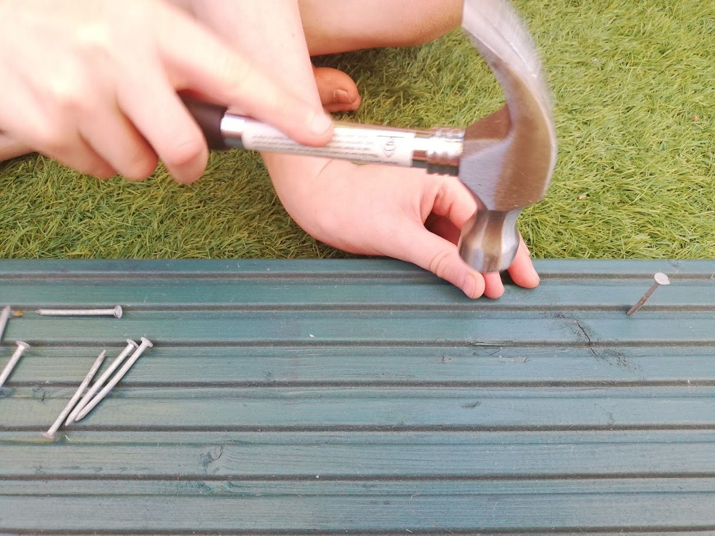
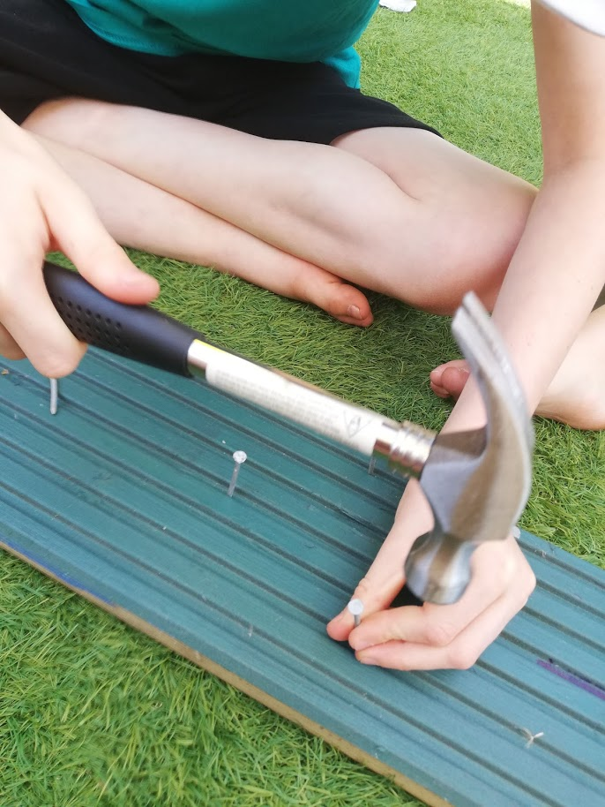
First you need to hammer the 5 nails into the piece of wood.
Space them out, not too close.

Slide 5
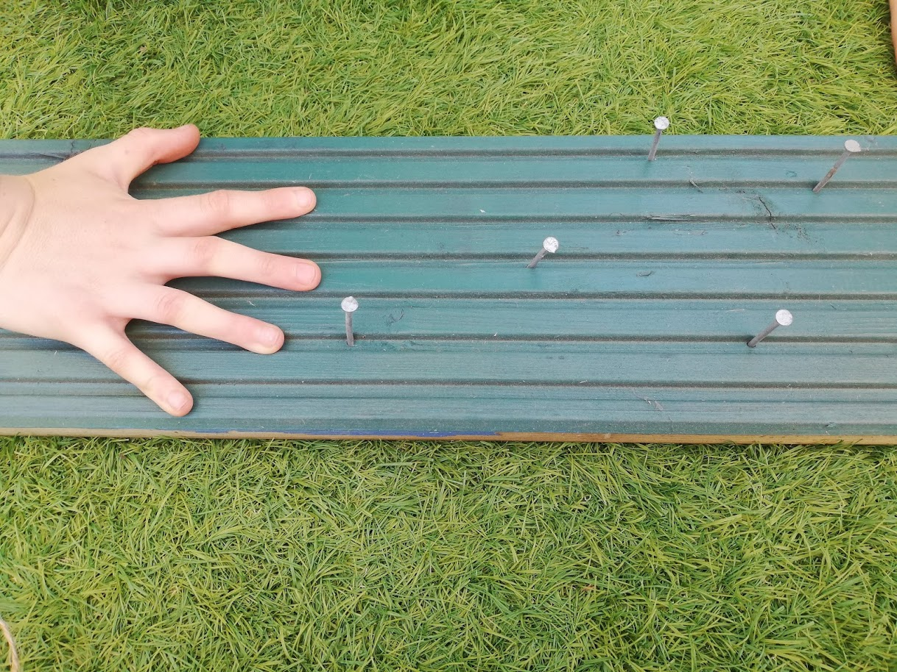
You will have 5 nails, spaced out across the piece of wood.
You need to make sure the nails do not wobble and are secure in the wood.

Slide 6
Remember how we think about prayer in 5s?
Now I would like you to think that each nail represents a person or item or symbol in the world…

Slide 7
Spend some time thinking about the 5 you have chosen
My pet dog
Sunny days
The Earth
My parents
My best friend

Slide 8
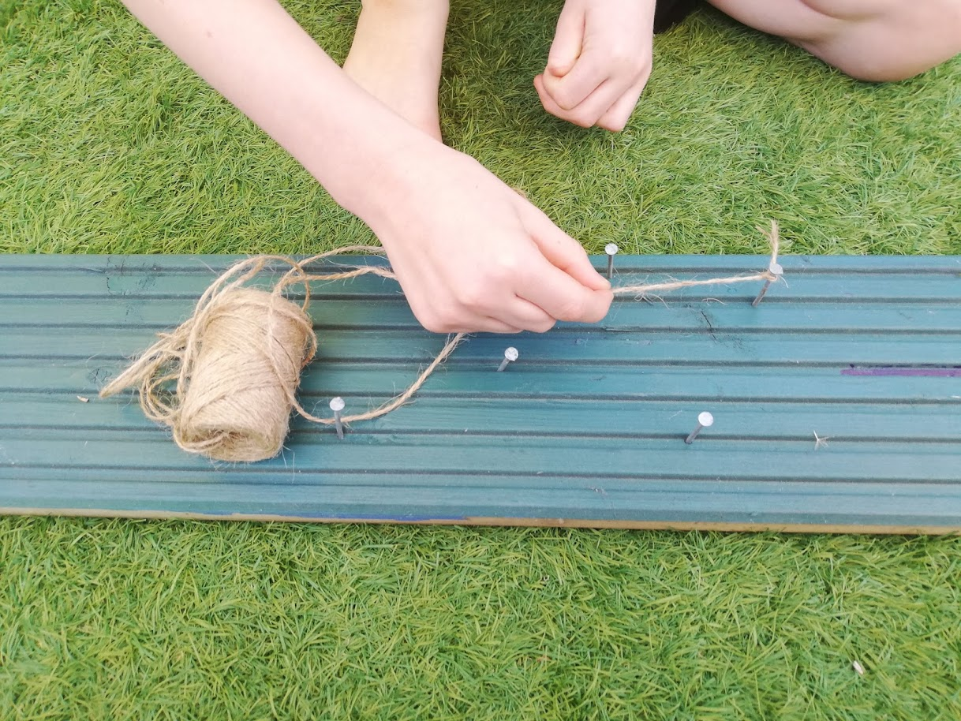
Now tie and knot some yarn or string to one of your nails.
Think about who or what that nail represents. Talk to God about them. Thank God, praise God, ask God to help or heal them.
This can be done silently or out loud. Think about what makes them special to you.

Slide 9
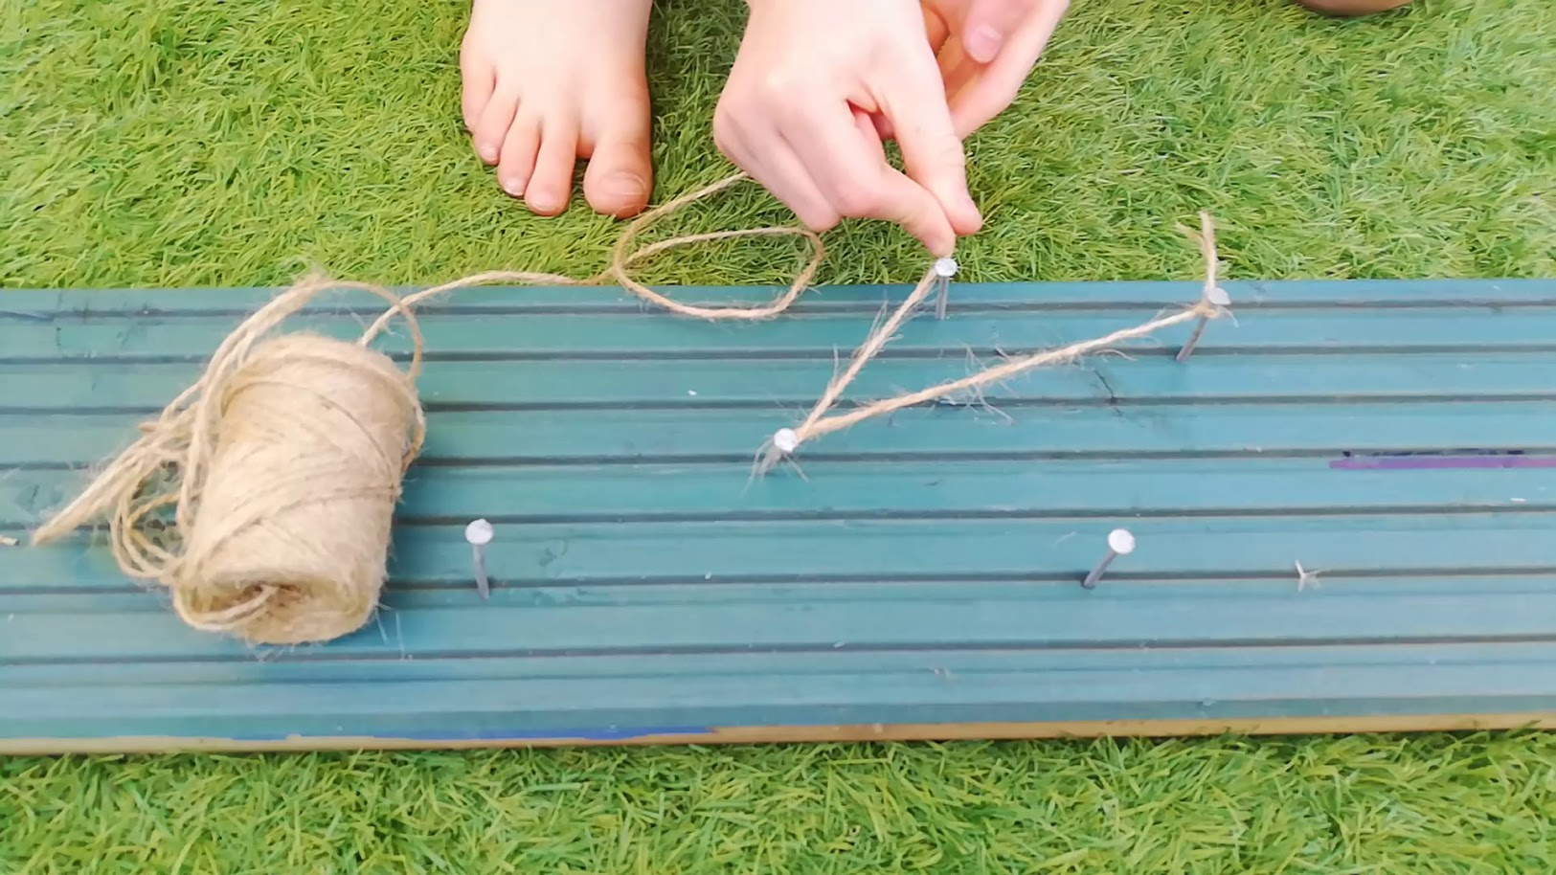
Then move your yarn or string around all of the nails in your wood.
Think about each nail as someone or something special.
Move onto the next nail when you are ready.
Wind the string around the nail for as long as you like.

Slide 10
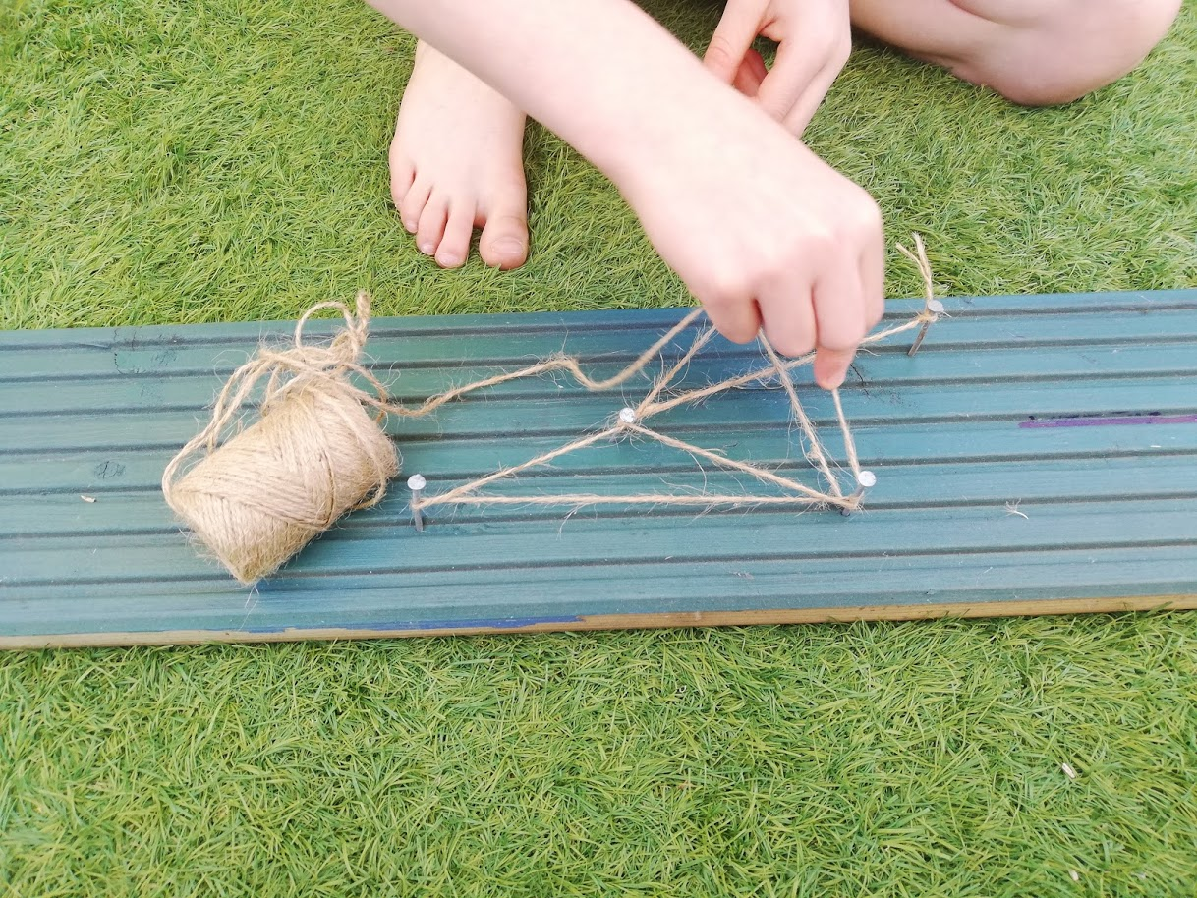
Revisit nails if you want to think about them again.
As you move and wind your string around the nails you will create a ‘web’ effect.
A prayer web.

Slide 11
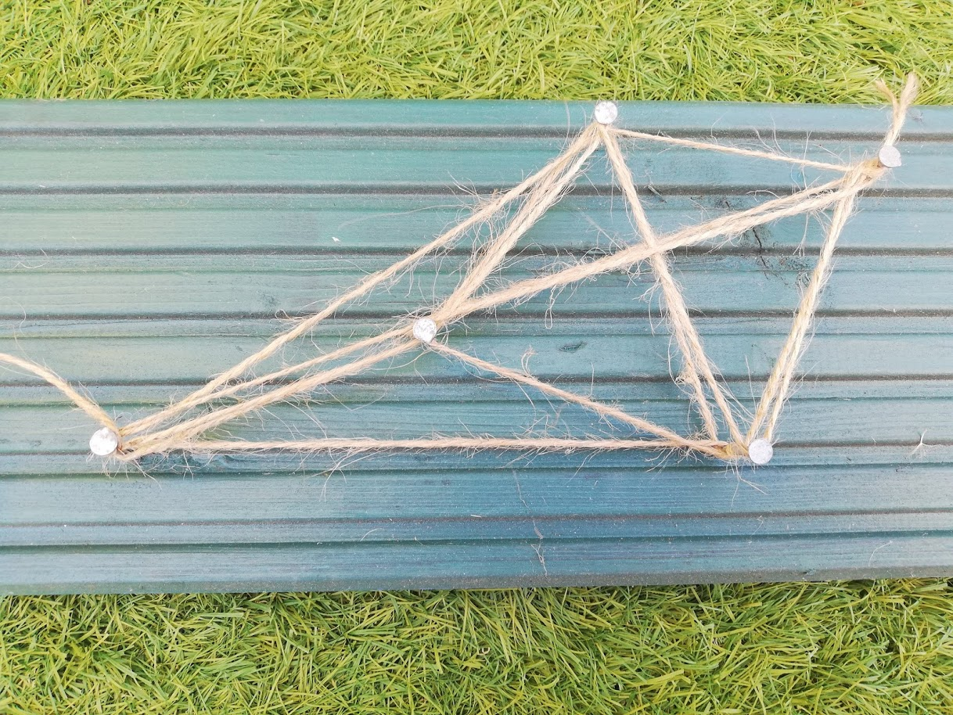
This was my final prayer web.
The best thing about creating prayer webs is you can keep them or slowly unwind the yarn, taking those moments to be silent, safely remove the nails and place them away for another day of creative prayer.

