Slide 1
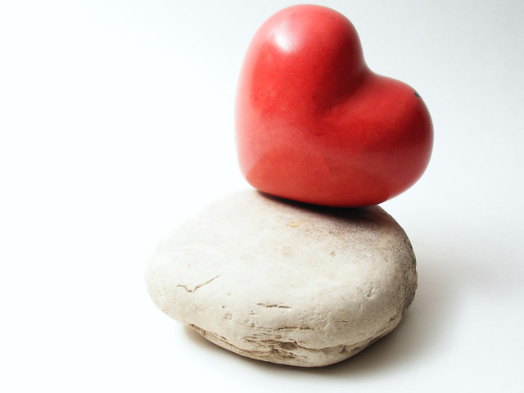
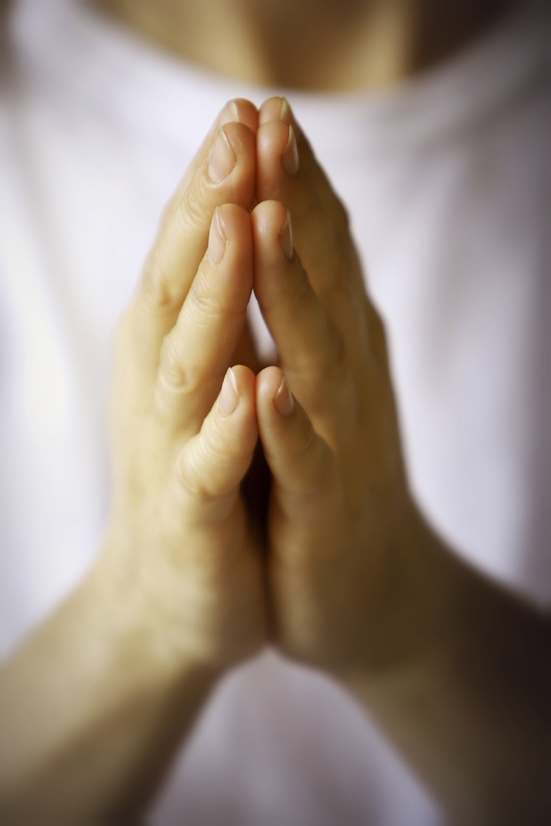
Prayer Rocks

Slide 2
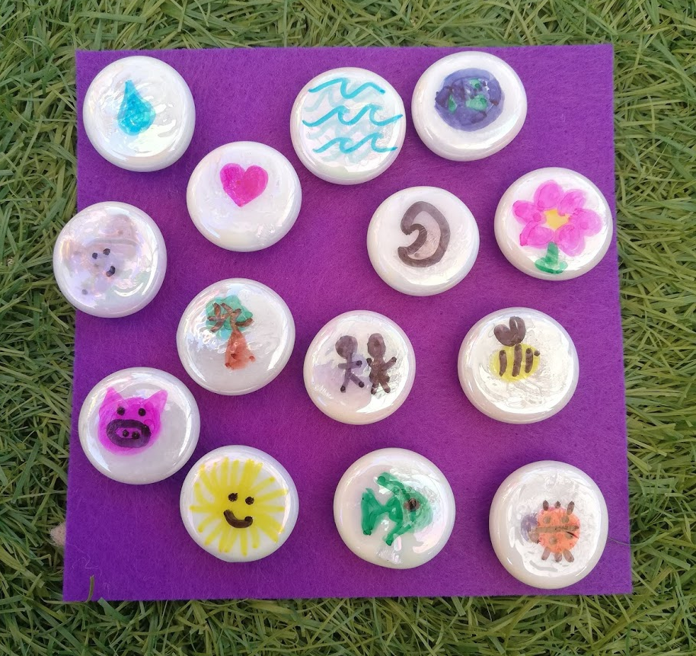
Prayer Rocks
This prayer follows the same idea of ‘Love on Rocks’.
Paint or decorate some rocks with the things you are thankful for having in the world.

Slide 3
Prayer Rocks
Decorate them and then choose one of words below to invite someone to think about God.
friendship | peace
thanks | heal
compassion | gift
happiness | love
blessing | praise
kindness | hope

Slide 4
Prayer Rocks
Then hide them around where you live.
Every time you hide one, say a little prayer to God about what you have drawn or the word you have chosen.

