Slide 1
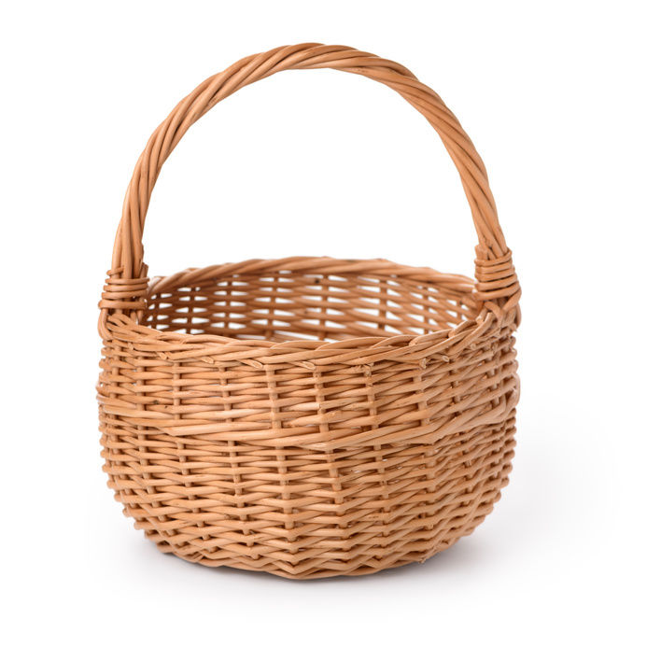
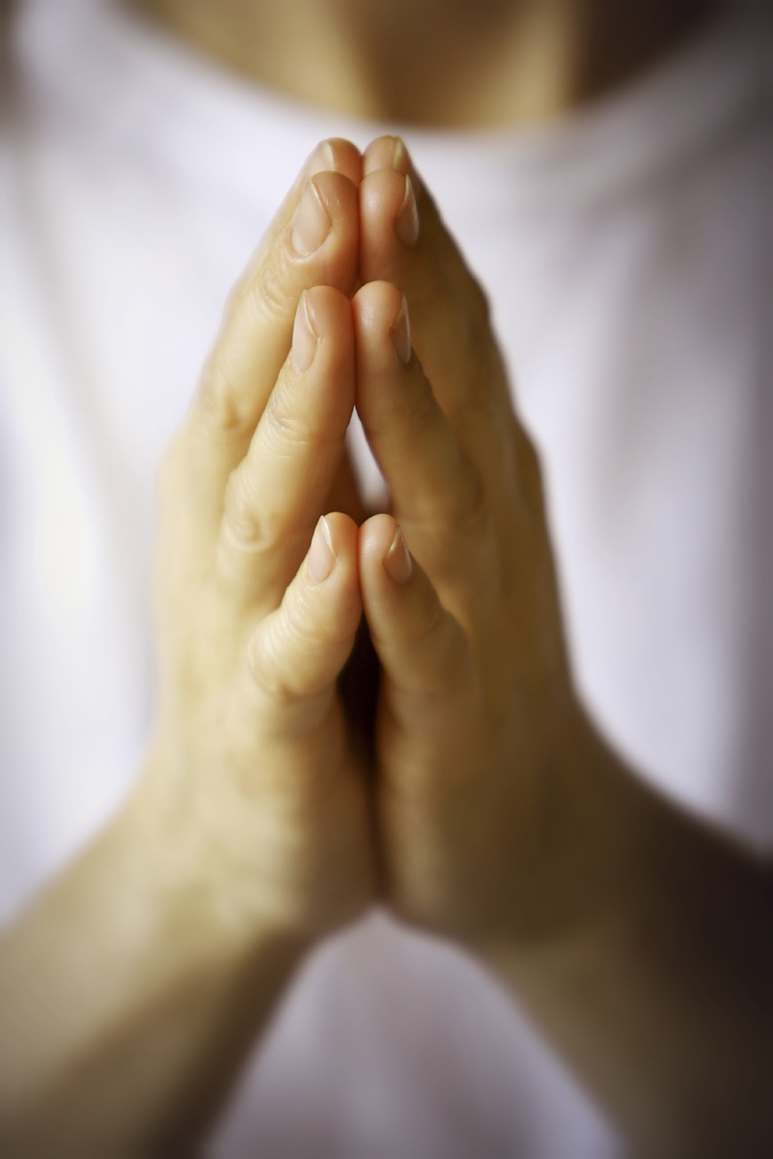
Prayer Baskets

Slide 2
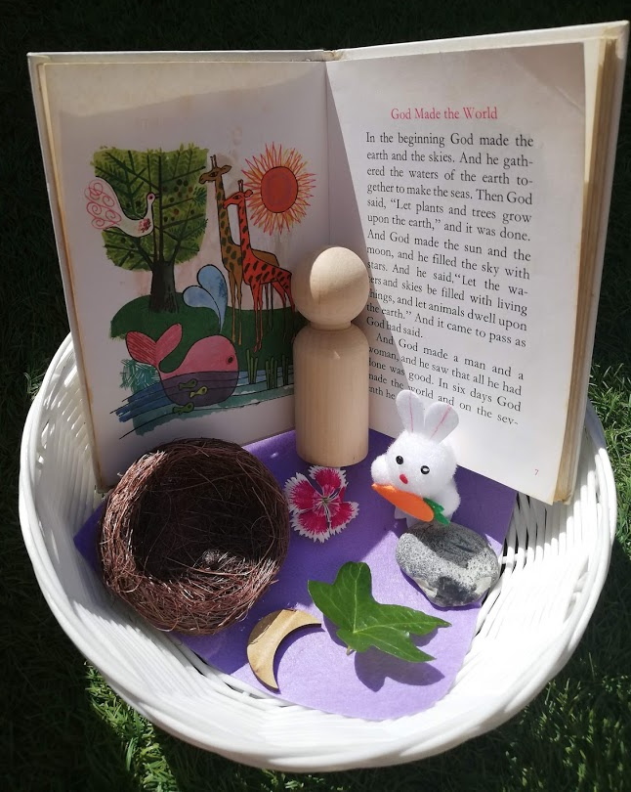
Prayer baskets are a lovely way to put things together for a prayer.
This prayer basket helps us to think of a Bible story.
Can you tell what the story is?

Slide 3
The story comes from the book of Genesis.
Inside my basket you can see…
A man
A rabbit
A stone
A leaf
A flower
A nest
The moon

Slide 4
The story is about the things God made in the ‘Creation story’.
You can find stories in the Bible and create a basket to help you think of a prayer.

Slide 5
This prayer could talk to God about how you feel or think about:
Gratitude
Thanks
Care
Love
Kindness
Compassion
Peace

Slide 6
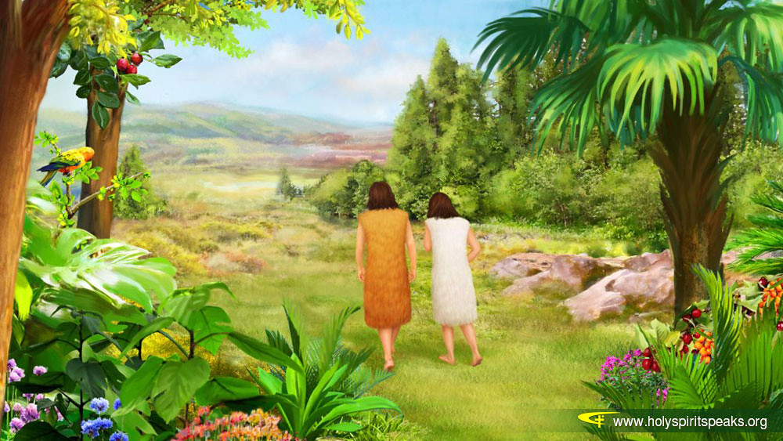
Do you know this Bible story?
What would you include for Adam and Eve? What would you pray about?

Slide 7
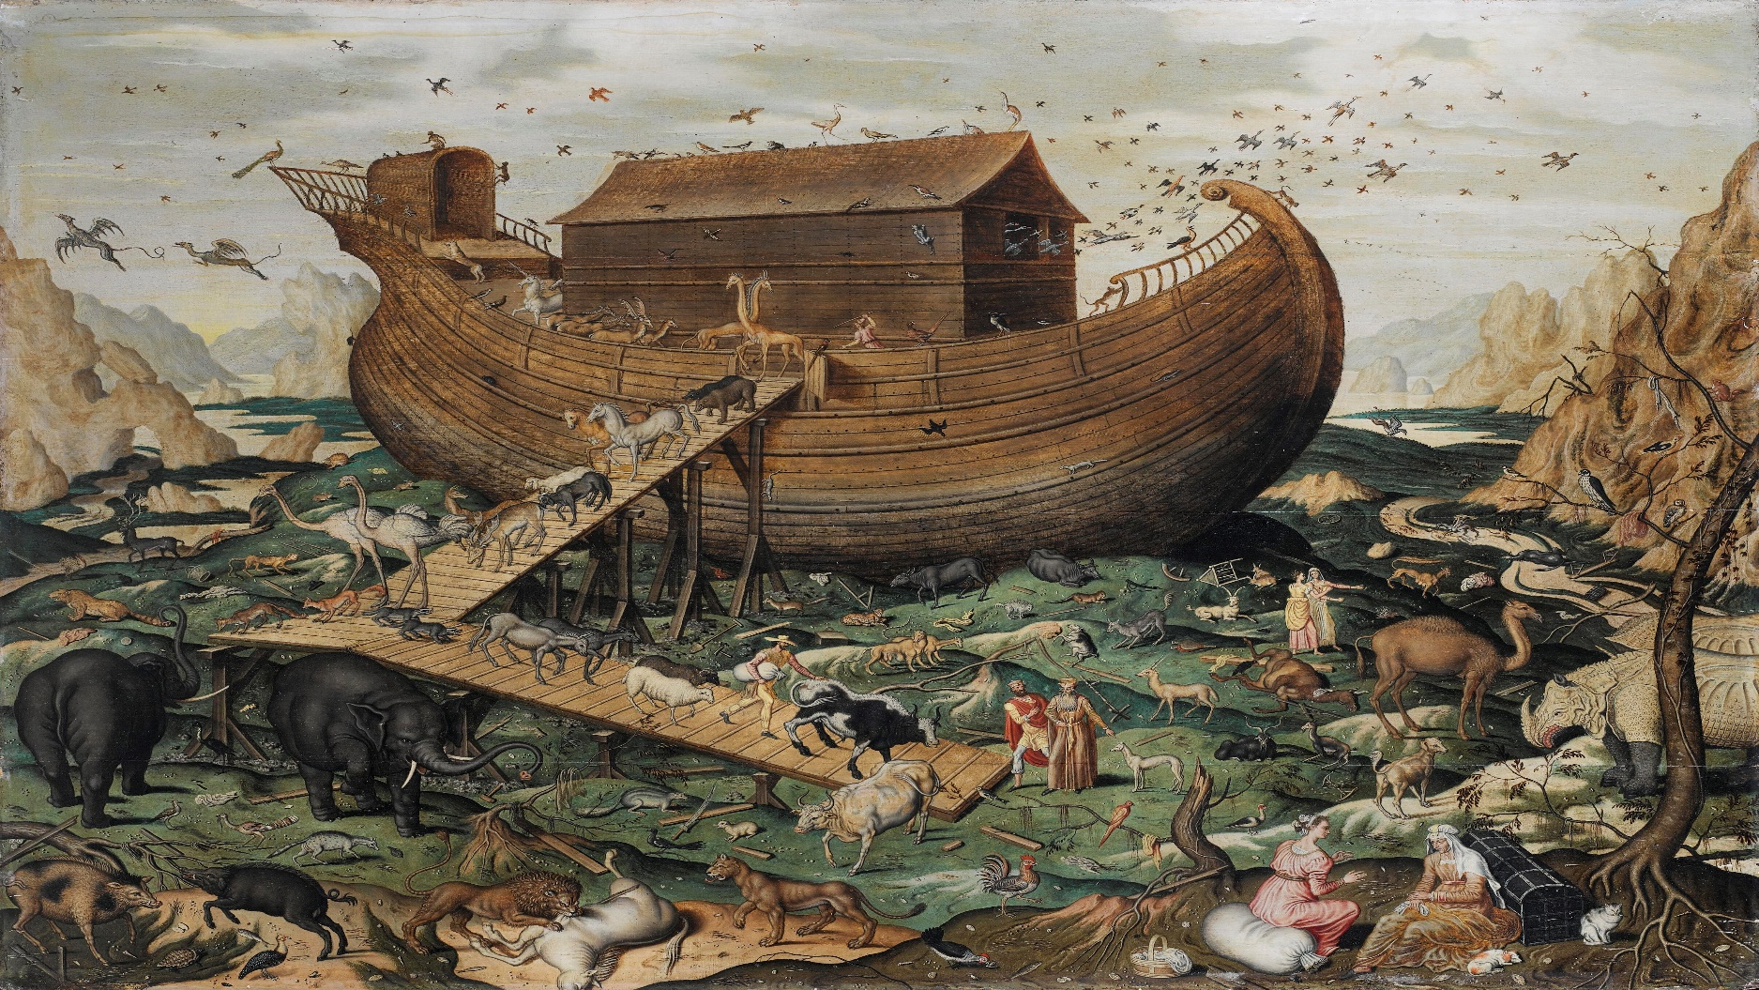
Do you know this Bible story?
What would you include for Noah’s ark? What would you pray about?

Slide 8
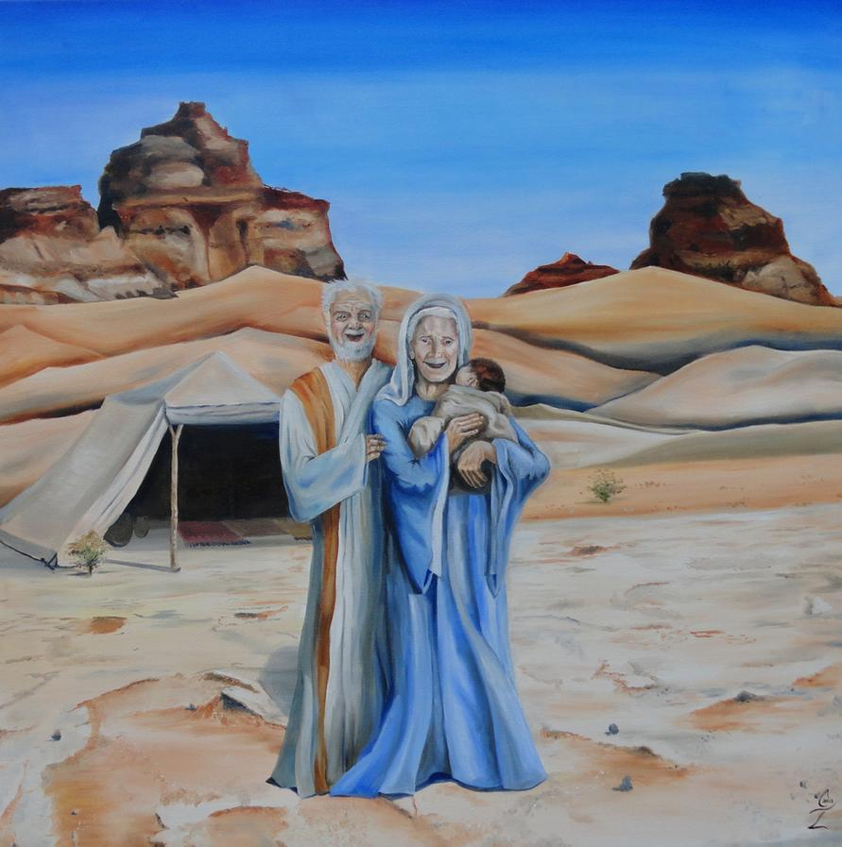
Do you know this Bible story?
What would you include for Abraham and Sarah? What would you pray about?

Slide 9
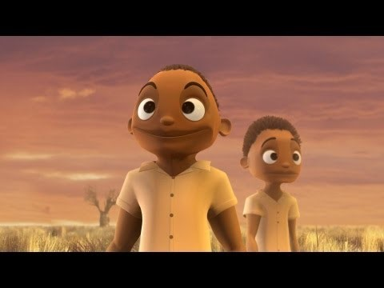
Do you know this Bible parable?
What would you include for the ‘Wise and Foolish’ builder? What would you pray about?

Slide 10
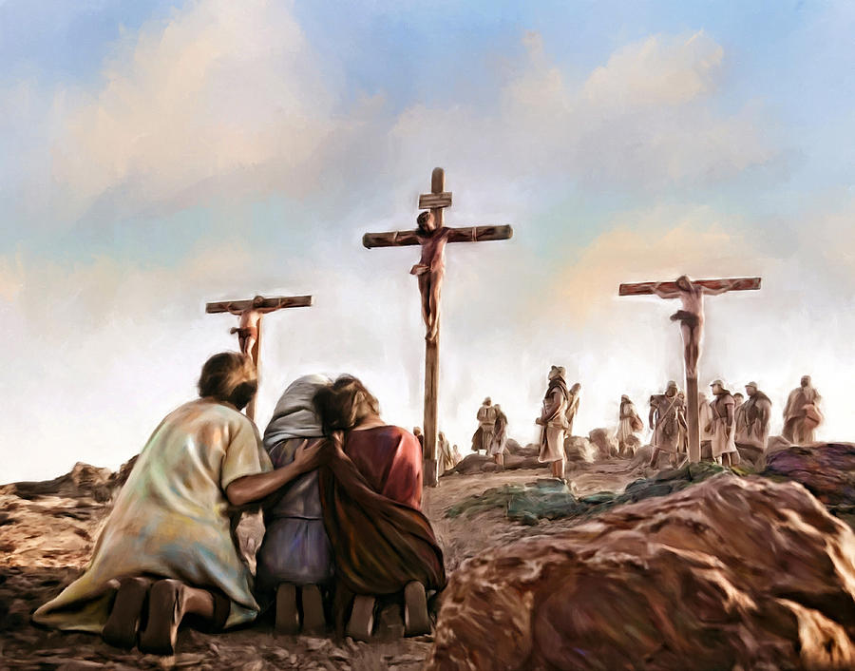
Do you know this Bible story?
What would you include for Jesus’ crucifixion? What would you pray about?

