Slide 1
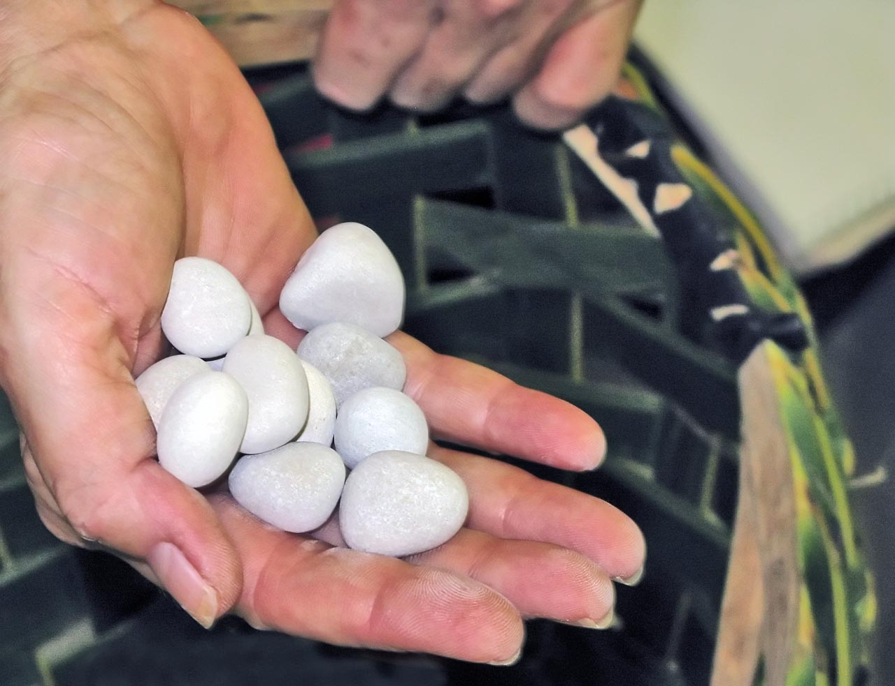
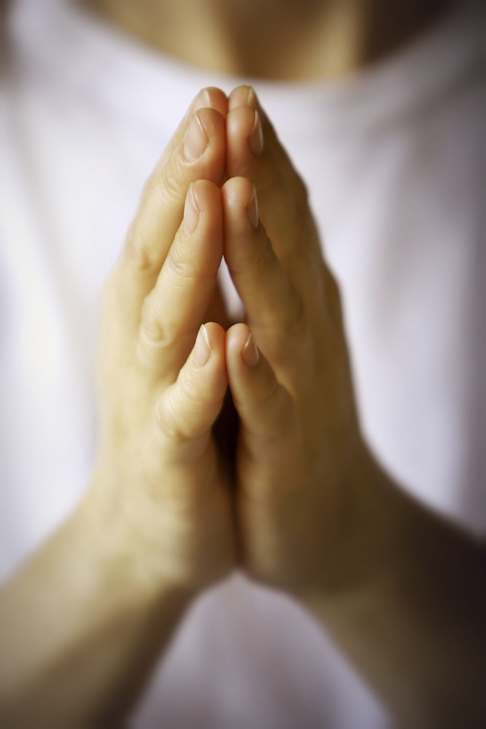
Pebble Prayers

Slide 2
You can say a prayer in many different ways.
Prayers are not only said in the hall for Collective Worship or before leaving the school day.
There are many different ways to pray and speak to God. Over the next few RE lessons you will be able to explore prayer and how to become more spiritual through practical and creative ways.
However, you do not need to say prayers to God if you do not want to. You can spend a small amount of time in the day to be still, reflective, thinking of others or the things you are grateful for in your life. You can use these prayer ideas as stimulus.

Slide 3
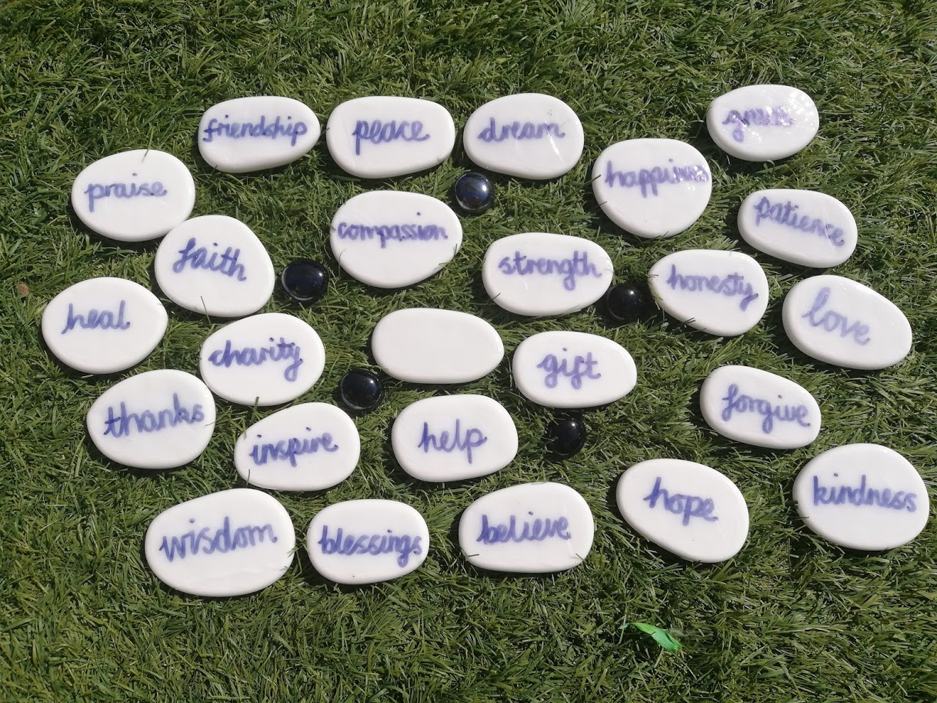
Go on a walk and find a selection of stones, pebbles or shells. When you get home label them with a selection of your favourite words from below:
peace | friendship
praise | faith
heal | charity
thanks | inspire
blessings | wisdom
compassion | dream
strength | gift
hope | forgive
happiness | honesty
grace | patience
love | kindness

Slide 4
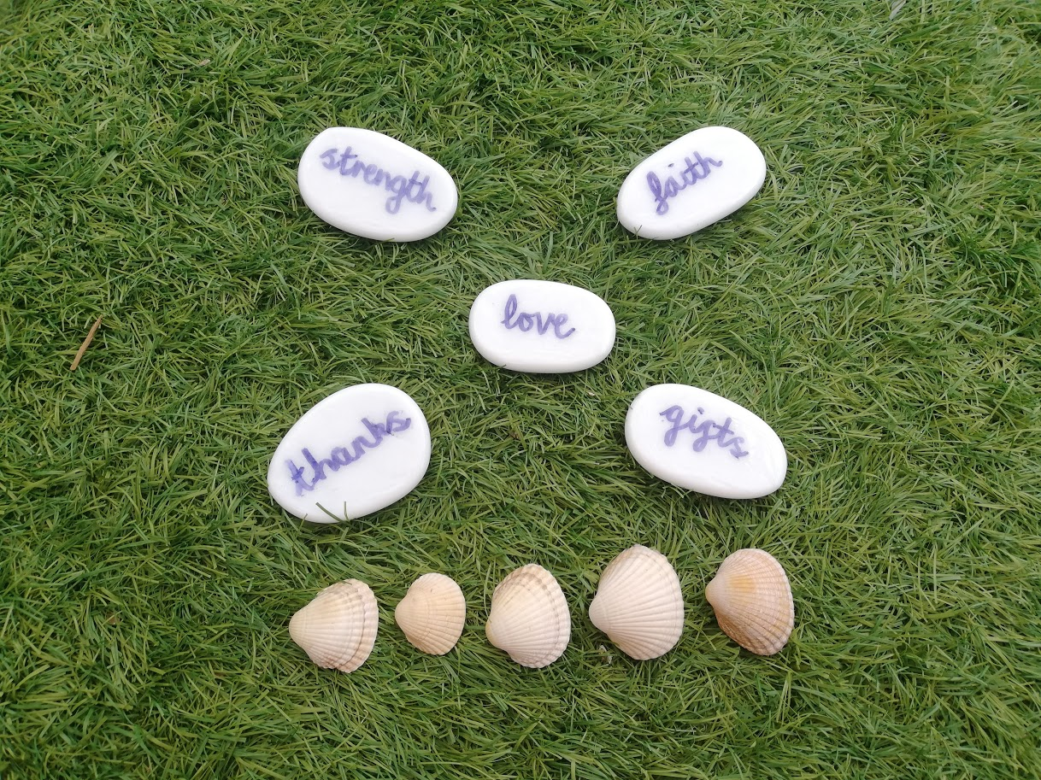
Place 5 words on a flat surface.
Then select 5 different stones, pebbles or shells.
In my example each shell represents someone or something important to me.

Slide 5
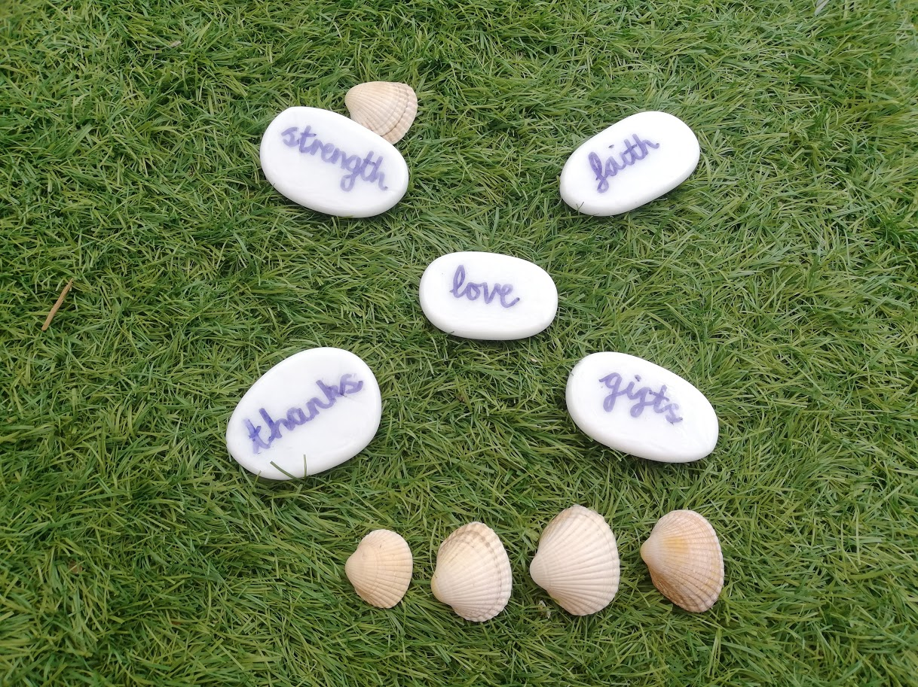
Then place a shell next to the word stone and pray to God about an important person, thing or yourself.
For example:
Dear God,
Please give Sam the strength to heal and recover.
Amen

Slide 6
Dear God,
Please let John feel the love we have towards him.
Amen
Dear God,
Thank you for giving us this beautiful world. I love hearing the birds singing in the morning.
Amen

Slide 7
Dear God,
Give me the faith that you will help me when I need you.
Amen
Dear God,
Your gifts are opened each and every day when I open my curtains and see the world.
Amen

Slide 8
Or turn all of your stones over so you cannot see the words.
Choose a small selection and these words will become the focus words for your prayer.

Slide 9
For example:
Dear God,
May I always feel your love for me. May I always give thanks for the gifts you present me.
May you give me the wisdom to make the right choices.
May you help those in need around the world.
Amen

