Slide 1

Mr Men and Little Miss Prayers

Slide 2
You can say a prayer in many different ways.
Prayers are not only said in the hall for Collective Worship or before leaving the school day.
There are many different ways to pray and speak to God. Over the next few RE lessons you will be able to explore prayer and how to become more spiritual through practical and creative ways.
However, you do not need to say prayers to God if you do not want to. You can spend a small amount of time in the day to be still, reflective, thinking of others or the things you are grateful for in your life. You can use these prayer ideas as stimulus.

Slide 3
This type of prayer uses characters from the famous book collection ‘Mr and Little Miss’ books.
The characters help you to focus a prayer to God by thinking of their name or personality.
As an extra challenge, you could make up your own character for your prayer focus. You could write your own story or comic strip about them too.
To pray using this idea, you could draw a picture of the 3-4 characters you have chosen, print pictures or look at their books. Keep turning through this power point to find out how to use these book characters in prayer. Have fun!

Slide 4
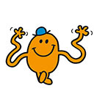


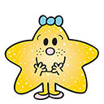


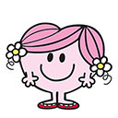
Mr. Happy
Mr. Cheerful
Little Miss Giggle
Mr. Tickle
Little Miss Fun
Little Miss Sparkle
These characters make us feel happy, positive and smiley.
Use these characters to help you pray for something or someone good in your life.
Think about people who make you happy, laugh, fun or make you feel good.
Thank God for the people in your life that make you sparkle.
Thank God for people who make you feel safe, warm and loved.
Little Miss Hug

Slide 5
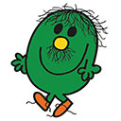
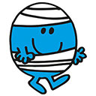
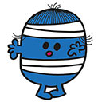

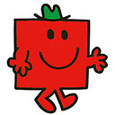

Mr. Strong
Mr. Brave
Mr. Clumsy
Mr. Bump
Little Miss Whoops
Mr. Sneeze
These characters make us feel strong and brave.
Use these characters to help you pray for someone in your life who is strong or brave.
Think about people who may be ill or have struggles in their life.
Ask God to help those who need support or who are courageous.
These characters make us think about people who are poorly, ill or hurt.
You can use these characters to help you think of others, those in need.
Think about family and friends who are suffering.
Think about people around the world who are poorly or living in poverty.

Slide 6
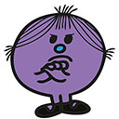
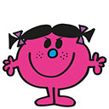
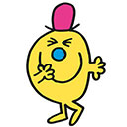

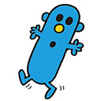
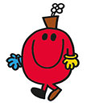
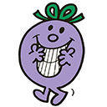
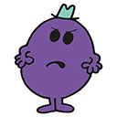
Little Miss Stubborn
Little Miss Bad
Little Miss Bad
Little Miss Scary
Mr. Mischief
Mr. Mean
These characters make us think about our negative behaviours, the things we do wrong.
You can use these characters to help you think of ways to be a better person by reflecting on the bad things we do in life.
Think about your actions, behaviour and choices and how you can improve or change things.
Little Miss Naughty
Mr. Wrong
Mr. Grumble

Slide 7
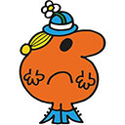
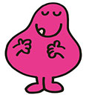
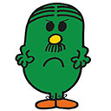
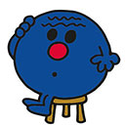
Little Miss Greedy
Mr. Greedy
Mr. Worry
Mr. Fussy
These characters make us think about the times when we have not shared.
Use these characters to help you pray to learn how to share and take turns.
Think about the times you have been greedy, with toys, food, sweets.
Pray for strength to make you a better person and help you to share and take turns.
These characters make us think about the way we live our lives.
Use these characters to help you pray to share your worries and woes. Sometimes we can be fussy and stress.
Pray to God for strength to be brave and strong to share your worries, stresses or fears.

Slide 8




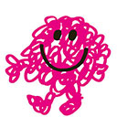
Little Miss Tidy
Mr. Messy
Mr. Rude
Mr. Loud
Mr. Grumpy
These characters make us think about the way we talk to others.
Use these characters to help you pray to become more polite.
Think about people who you have been rude or grumpy with, say sorry.
Pray for strength to make you a better person and help you to speak graciously.
These characters make us think about the way we live our lives.
Use these characters to help you pray to become more organised and prepared.
Think about the times you have been messy and dirty.
Pray for strength to make you a better person and help you to keep things tidy and clean.

Slide 9
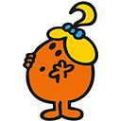

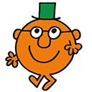
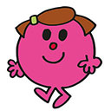
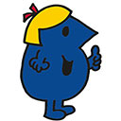
Little Miss Curious
Little Miss Wise
Little Miss Brainy
Little Miss Sunshine
Mr. Clever
These characters make us think about the way we learn.
Use these characters to help you pray to be more curious, to ask more questions and to become wise.
Think about people who help you to achieve things in life, your parents, your family, your friends, your teachers.
Pray to God to give you great talents.
This character make us think about the sun and happiness.
Use this character to say thank you for the sun and the things that make you shine.
Pray with thanks and gratitude for God’s creation and all that live upon it.

Slide 10
If you would like to, please share your ‘Mr and Little Miss Prayer’ with the class.

