Slide 1
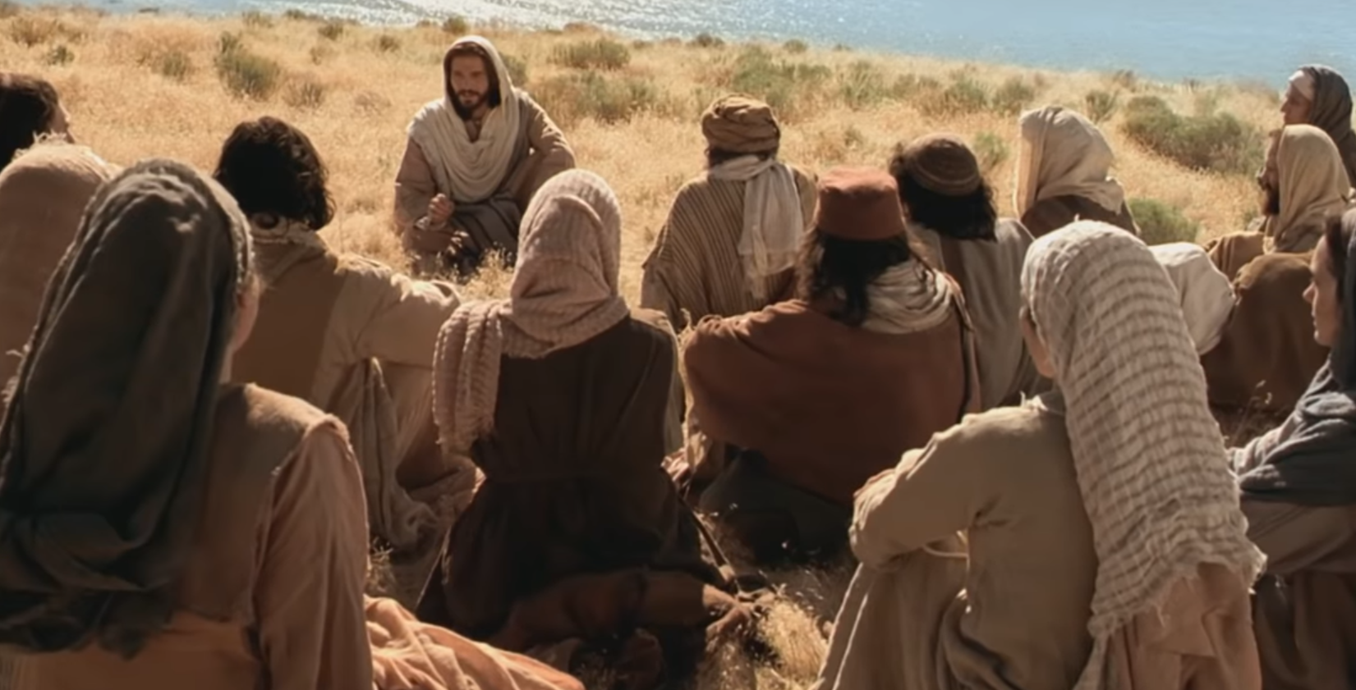
Sermon On The Mount Continues
Jesus took his disciples and followers somewhere quiet. They sat together and said “Lord, teach us to pray”.
This is found in Matthew and Luke’s gospel called ‘Sermon on the Mount’.

Slide 2
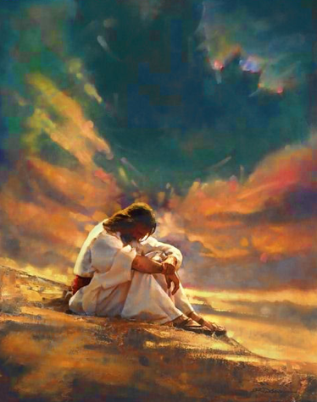
Sermon On The Mount
Jesus knew all about prayer.
He prayed early in the morning.
He prayed late into the night.
He prayed for his friends and for those who would have counted themselves his enemies.
He prayed for little children. He laid his hand upon them and he blessed them.
During his Sermon on the Mount, Jesus taught his disciples a very important prayer. It is inside every Bible ever written. It is said in every church. It is known by almost every Christian.

Slide 3
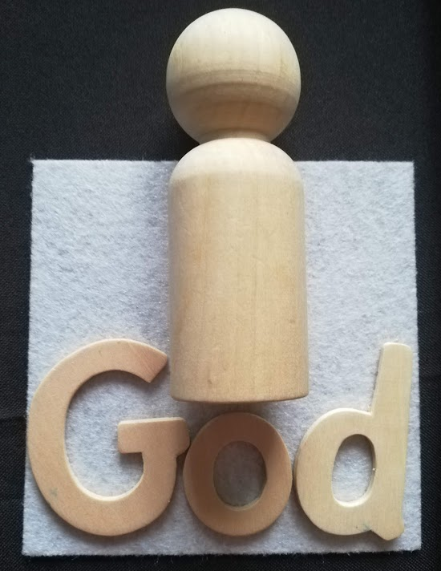
Jesus wanted us to know:
Your heavenly Father is better than the best father you could ever imagine.
He cares for you so much that he wants you to call him ‘Father’.

Slide 4
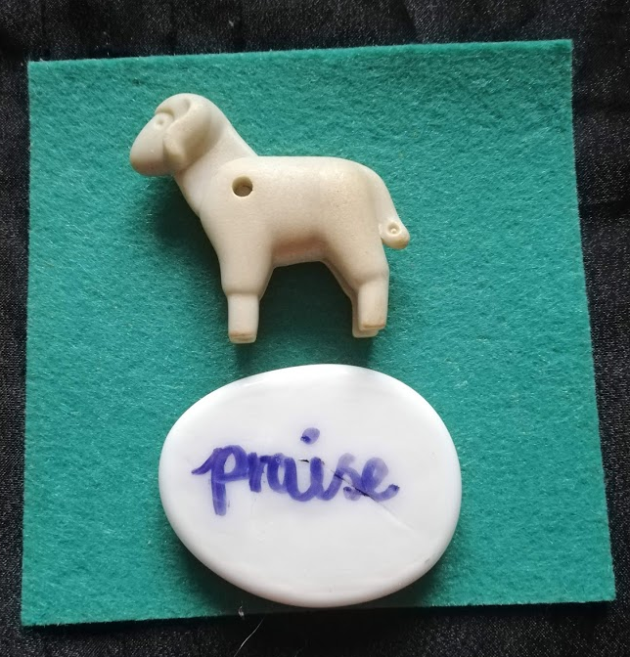
He loves you even more than a shepherd loves his sheep.
You should start your prayer with
Our father who art in heaven,

Slide 5
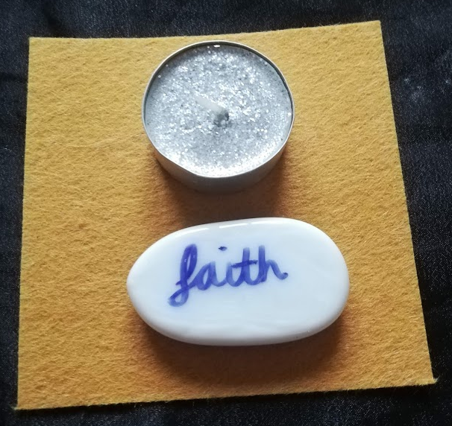
And remember when you pray that your heavenly Father is very holy.
He is all that is good, all that is light, hallowed means holy.
So we say:
Hallowed be your name,

Slide 6
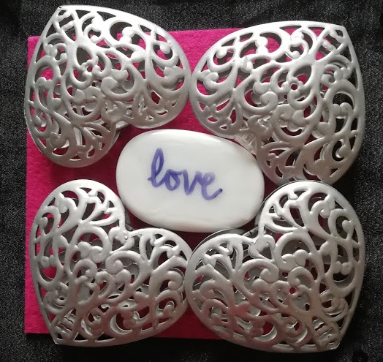
Your heavenly Father loves you so much that he has spread his love to every corner of the world.
You can feel His love in the North, South, East and West.

Slide 7
There is no part of the world that your heavenly Father does not care for.
There is no part of the world that he does not want us to care for.
He loves us from His heavenly home.

Slide 8
Now you say:
Thy kingdom come, thy will be done, on earth as it is in heaven.

Slide 9
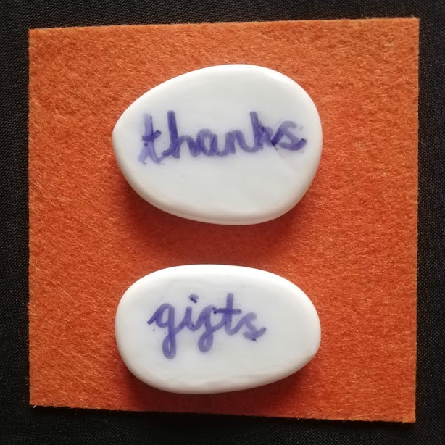
Your heavenly father loves you so much that he wants you to have every good thing you need.
He gives those things to us but he loves us to ask for the things we need. He loves us to share our lives with him.

Slide 10
Our daily bread is not just the toast we have for breakfast, or the honey sandwich we have for tea.
No, it’s everything we need, our friends, our families, our homes, clothes to keep us warm, food and love to nourish us

Slide 11
Now you say:
Give us this day our daily bread,

Slide 12
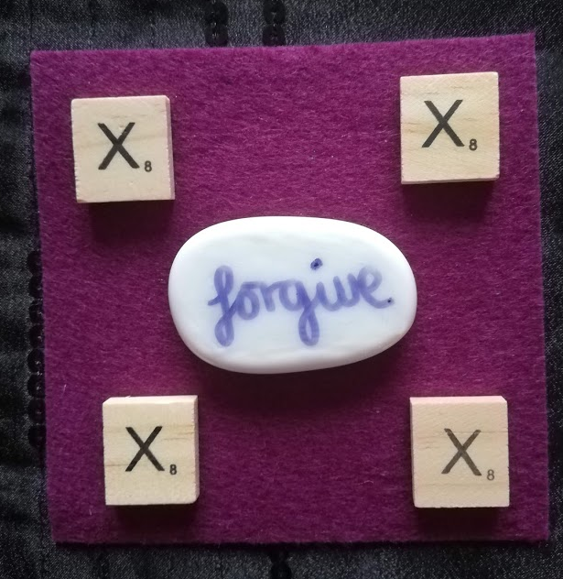
This part of the prayer is all about God’s love for us.
He knows that we don’t always get things right.
He has given us ten ways to help us live to help us know when we get things wrong.

Slide 13
The colour purple is for forgiveness in Christianity.
Next we say:
Forgive us our sins,

Slide 14
And God wants us to love as we are loved, this part of the prayer is about what we can do for others.
Next we say:
As we forgive those who sin against us.

Slide 15
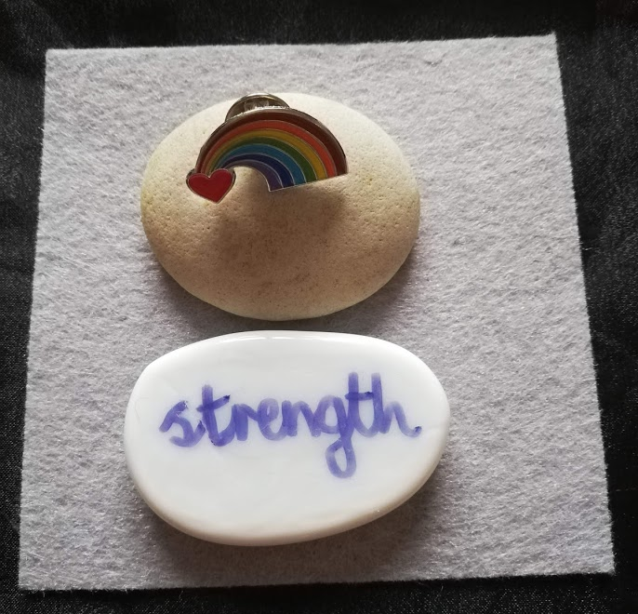
God knows that there are things that make us stumble and fall.
There are grey areas when we are not sure whether we are doing right or wrong.

Slide 16
Perhaps there are times when we know that we are doing wrong but we want to do that thing all the same.
But God has given us the sign of the rainbow to remind us that he will never, ever turn his back on us, he will never, ever let us go.

Slide 17
Now we say:
Lead us not into temptation,
But deliver from evil,

Slide 18
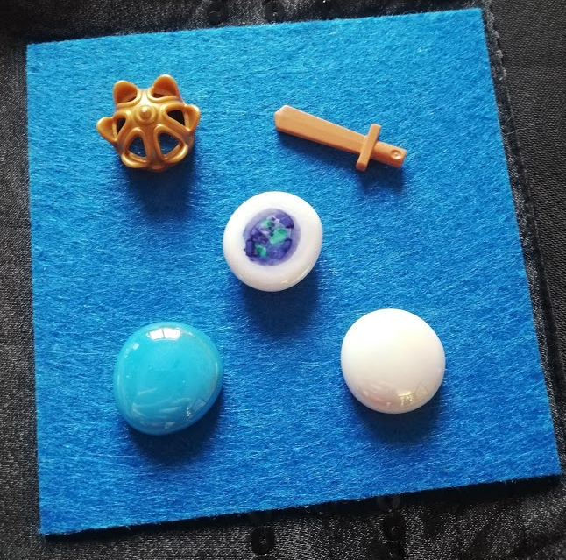
This is part of the prayer that you will not find in every Bible.
King Henry VIII added it to the prayer. He named himself the King of the church and he wanted the prayer to end with the praises for God and His eternal love for us.

Slide 19
Finally we say:
For yours is the kingdom, the power and the glory.
Forever and ever. Amen

Slide 20
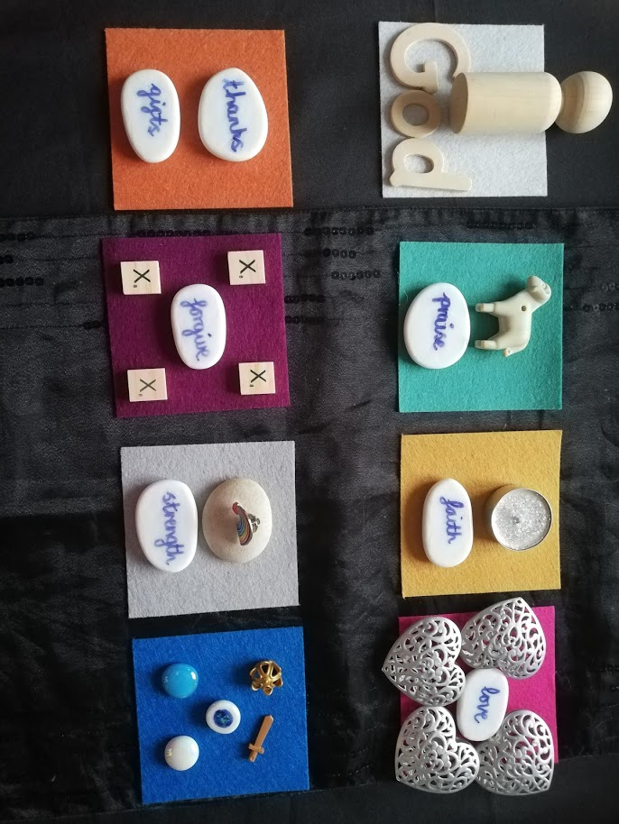
Lets put it all together:
Our Father,
Who art in Heaven,
Hallowed be thy name,
Thy Kingdom come,
Thy will be done,
On Earth as it is in Heaven,
Give us this day, our daily bread,
As we forgive us our sins,
As we forgive those who sin against us,
And lead us not into temptation,
But deliver us from evil,
For yours is the kingdom, the power and the glory,
Forever and ever,
Amen

Slide 21
Why don’t you have a try at writing your own prayer using Godly play?
You need:
Small squared pieces of coloured card to plan each part of your prayer. 8 is the most you will need.
Place objects, symbols or words onto the coloured card to help you remember your prayer lines.
Take a picture and then try to write your prayer onto paper.

