Slide 1


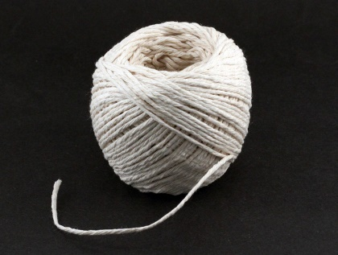
The 5 String Prayer

Slide 2
You can say a prayer in many different ways.
Prayers are not only said in the hall for Collective Worship or before leaving the school day.
There are many different ways to pray and speak to God. Over the next few RE lessons you will be able to explore prayer and how to become more spiritual through practical and creative ways.
However, you do not need to say prayers to God if you do not want to. You can spend a small amount of time in the day to be still, reflective, thinking of others or the things you are grateful for in your life. You can use these prayer ideas as stimulus.

Slide 3
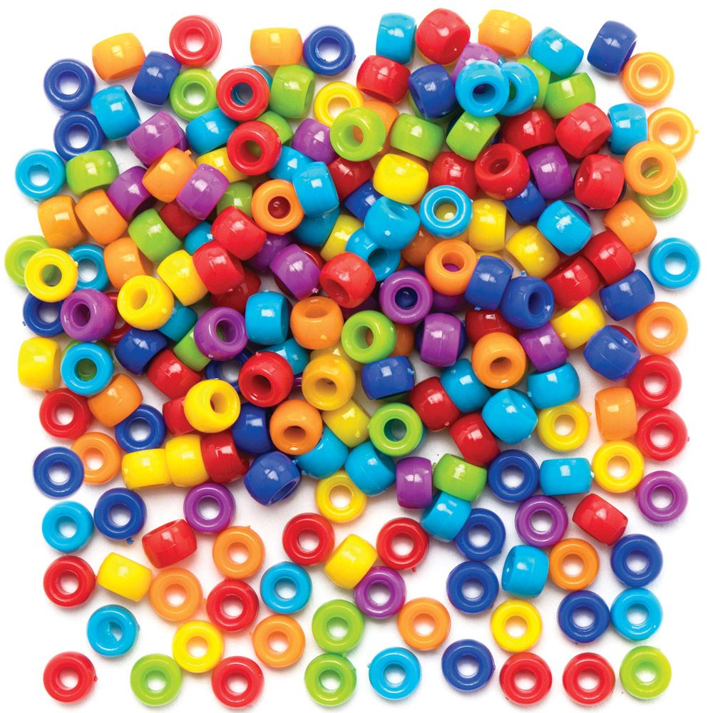



A simple and easy way to create a prayer is by making a bracelet or necklace.
All you need is a selection of items to thread, string, shoe lace or long piece of lace.
You can use beads or buttons or milk bottle tops with holes in.

Slide 4
Think of the number 5 as an important prayer number.
What I want you to do is think of 5 important people or amazing things in the world we live in.
Now thread 5 beads, buttons or bottle tops onto the string.

Slide 5
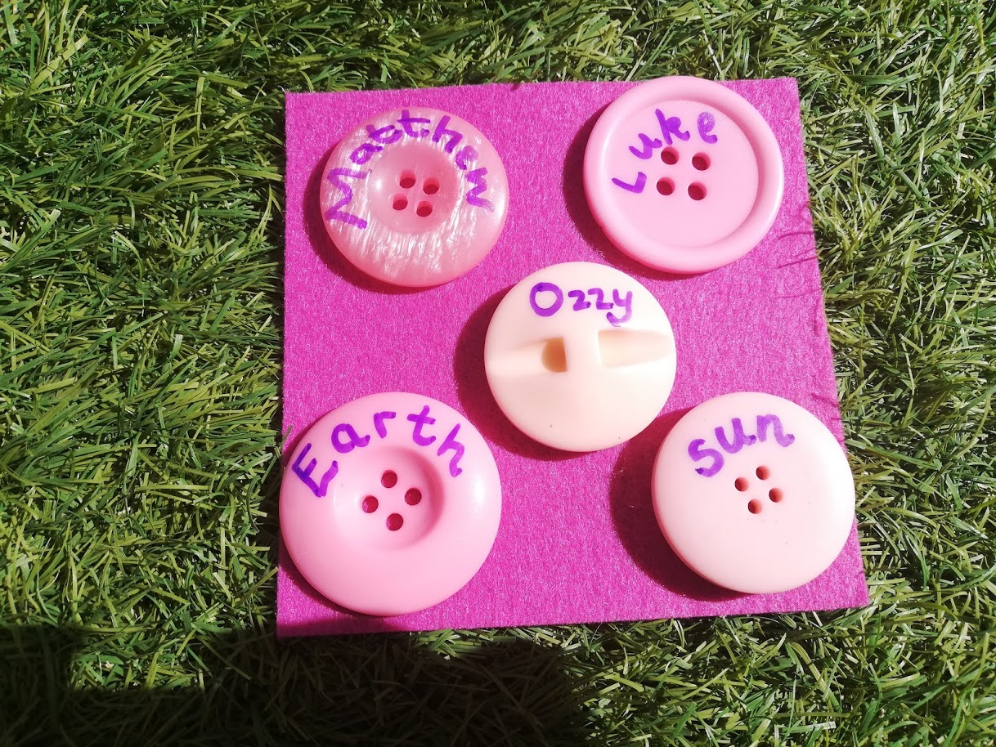
Then when you hold the item on the string spend some quiet time to think about that person.
You could say a prayer to God about that person or special thing.
You could say thank you to God.
You could pray for God to help them.
You could pray to God to keep them safe and healthy.

Slide 6
If you do not have objects to thread then go on a walk and make a daisy chain. Choose 5 flowers and when you join each daisy together think of someone special.
Or get a piece of string or lace and create 5 knots on the string. Each knot represents something or someone special to you. When you hold that knot in your fingers, pray or think of that someone special.

