Slide 1

5
Finger
Prayers

Slide 2
You can say a prayer in many different ways.
Prayers are not only said in the hall for Collective Worship or before leaving the school day.
There are many different ways to pray and speak to God. Over the next few RE lessons you will be able to explore prayer and how to become more spiritual through practical and creative ways.
However, you do not need to say prayers to God if you do not want to. You can spend a small amount of time in the day to be still, reflective, thinking of others or the things you are grateful for in your life. You can use these prayer ideas as stimulus.

Slide 3
For a 5 finger prayer, all you need is your hand!
Each finger represents someone in your life to think about in your prayer.
Your thumb – is for those who are closest to you, your parents, siblings, your grandparents, family and friends.
You need to chose one person and you pray for
Love
People close to me

Slide 4
For a 5 finger prayer, all you need is your hand!
Each finger represents someone in your life to think about in your prayer.
Your pointer finger – is for those who direct you in your life, they teach and guide you. For example teachers, doctors, nurses, priests.
You need to chose one person and you pray for
Wisdom
People who give you direction

Slide 5
For a 5 finger prayer, all you need is your hand!
Each finger represents someone in your life to think about in your prayer.
Your middle finger – is for those who are in authority. For example leaders, government, royalty.
You need to chose one person and you pray for
Guidance
People in authority

Slide 6
For a 5 finger prayer, all you need is your hand!
Each finger represents someone in your life to think about in your prayer.
Your ring finger – is your weakest finger, it is for those who need help. For example those who are ill, poor health, dying, in trouble or pain.
You need to chose one person and you pray for
Help
People who need help

Slide 7
For a 5 finger prayer, all you need is your hand!
Each finger represents someone in your life to think about in your prayer.
Your tiny finger – is for you and what you need. Remember God will help you with what you need, not necessarily what you want.
You need to pray for
Your needs
Yourself

Slide 8
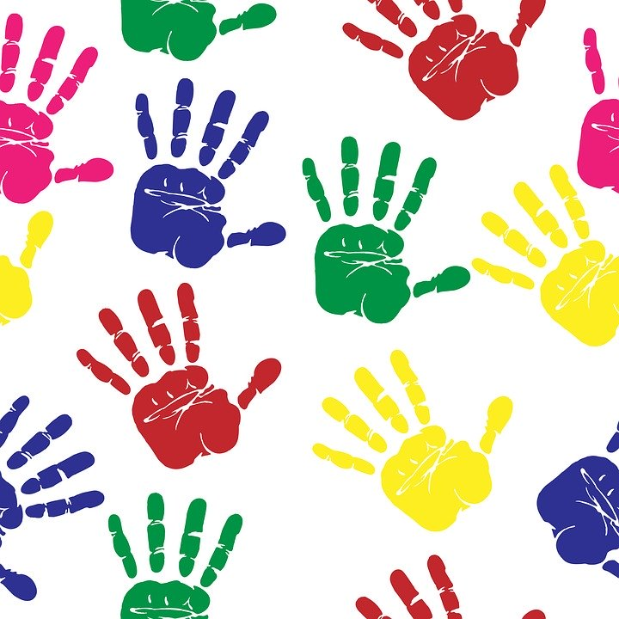
There are 2 things you can do now:
Find a quiet space, using your fingers, pray to God for your 5 important people, focussing on love, wisdom, guidance, help and you.
Get some paints. Paint your hands, maybe you could choose a different colour for each finger and make a beautiful hand print. Label each finger with the person you want to pray for.

